Slide 1

Basic Properties of Determinant
“Volume” in high dimensions
Notes:
History: may be we can mention the history of determinant in the future
Ref:
http://www.askamathematician.com/2013/05/q-why-are-determinants-defined-the-weird-way-they-are/

Slide 2
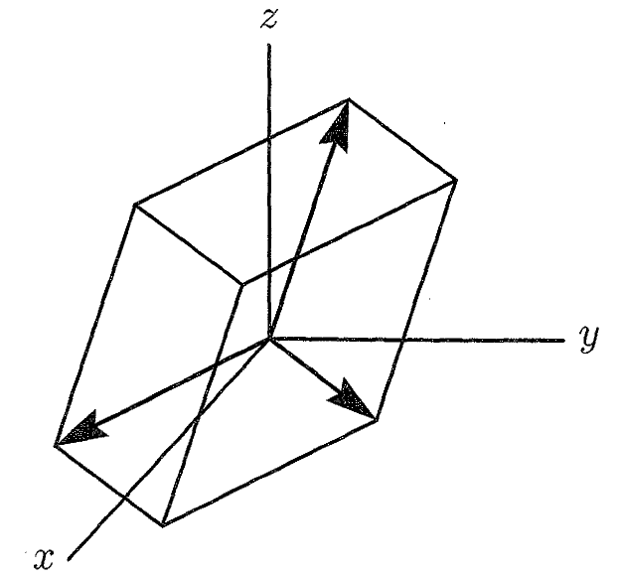

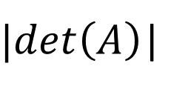




Determinant in High School
2 X 2
$$A=\left[\begin{matrix}a_{1} & a_{2} & a_{3} \\ a_{4} & a_{5} & a_{6} \\ a_{7} & a_{8} & a_{9}\end{matrix}\right]$$
3 x 3
$$A=\left[\begin{matrix}a & b \\ c & d\end{matrix}\right]$$
$$\left(a_{7},a_{8},a_{9}\right)$$
$|det\left(A\right)$|
絕對值!
(c,d)
V
(a,b)
$$\left(a_{1},a_{2},a_{3}\right)$$
$$\left(a_{4},a_{5},a_{6}\right)$$
Notes:
det(A) = volumn of box
How about A=I
How about A=Q (orthogonal matrix)
Draw a figure

Slide 3
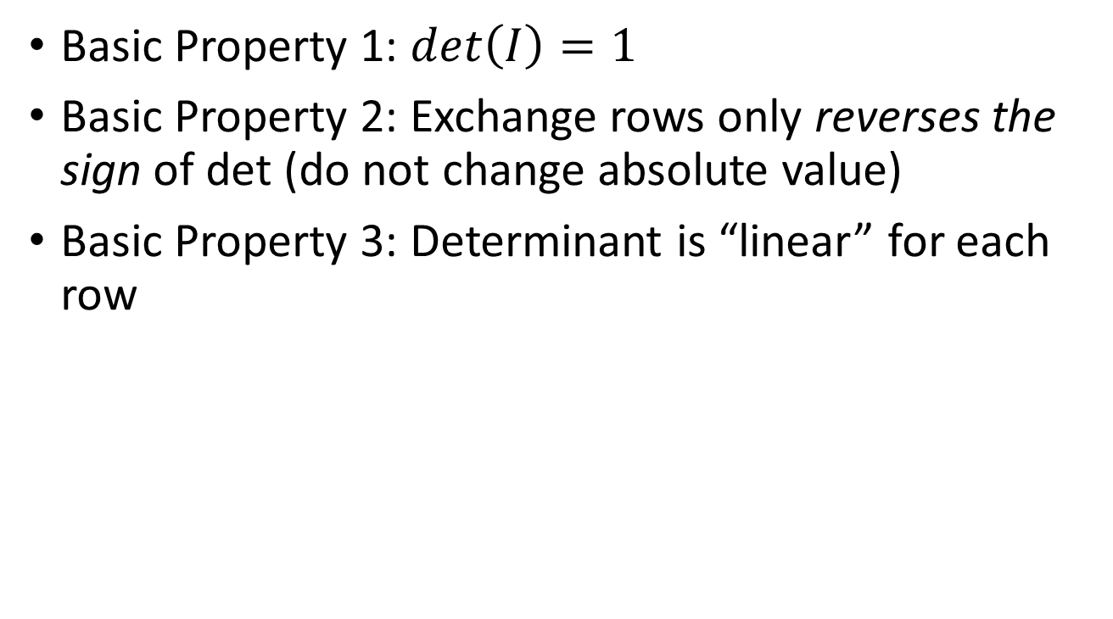
Three Basic Properties
Basic Property 1: $det\left(I\right)=1$
Basic Property 2: Exchange rows only reverses the sign of det (do not change absolute value)
Basic Property 3: Determinant is “linear” for each row
Area in 2d and Volume in 3d have the above properties
So det is “Volume” in high dimension?
Notes:
There is something called determinant. When determinant =0, the matrix is not invertible.

Slide 4





Three Basic Properties
Basic Property 1:
$det\left(I\right)=1$
正方形
面積為 1
正立方體
體積為 1
$$I_{3}=\left[\begin{matrix}1 & 0 & 0 \\ 0 & 1 & 0 \\ 0 & 0 & 1\end{matrix}\right]$$
$$I_{2}=\left[\begin{matrix}1 & 0 \\ 0 & 1\end{matrix}\right]$$
$$det\left(I_{2}\right)=1$$
$$det\left(I_{3}\right)=1$$

Slide 5
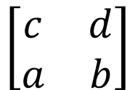
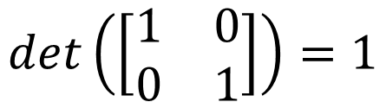

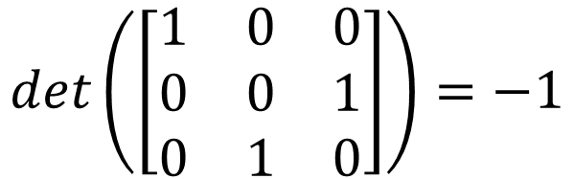

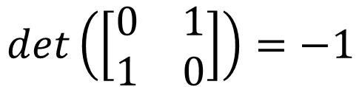
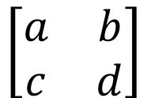
Three Basic Properties
$$\left[\begin{matrix}a & b \\ c & d\end{matrix}\right]$$
$$\left[\begin{matrix}c & d \\ a & b\end{matrix}\right]$$
Basic Property 2:
Exchanging rows only reverses the sign of det
$$det\left(\left[\begin{matrix}1 & 0 & 0 \\ 0 & 1 & 0 \\ 0 & 0 & 1\end{matrix}\right]\right)=1$$
$$det\left(\left[\begin{matrix}1 & 0 \\ 0 & 1\end{matrix}\right]\right)=1$$
$$det\left(\left[\begin{matrix}1 & 0 & 0 \\ 0 & 0 & 1 \\ 0 & 1 & 0\end{matrix}\right]\right)=−1$$
$$det\left(\left[\begin{matrix}0 & 1 \\ 1 & 0\end{matrix}\right]\right)=−1$$
$$det\left(\left[\begin{matrix}0 & 1 & 0 \\ 0 & 0 & 1 \\ 1 & 0 & 0\end{matrix}\right]\right)=1$$
Notes:
Check by geometry?

Slide 6



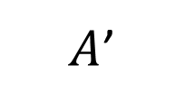


Three Basic Properties
Basic Property 2:
Exchanging rows only reverses the sign of det
If a matrix A has 2 equal rows
$$det\left(A\right)=0$$
exchange the two rows
$$A$$
$A$’
$$det\left(A\right)=K$$
$$=$$
$$det\left(A′\right)=−K$$
Exchanging the two equal rows yields the same matrix

Slide 7
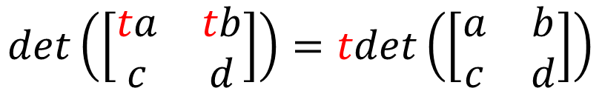
Three Basic Properties
Basic Property 3:
Determinant is “linear” for each row
3-a
$$det\left(\left[\begin{matrix}ta & tb \\ c & d\end{matrix}\right]\right)=tdet\left(\left[\begin{matrix}a & b \\ c & d\end{matrix}\right]\right)$$
(c,d)
(c,d)
V
V
V
(a,b)
(2a,2b)

Slide 8
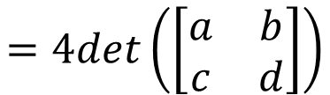

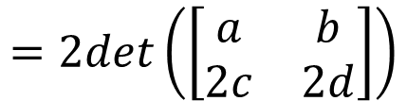
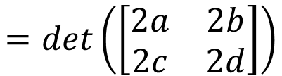
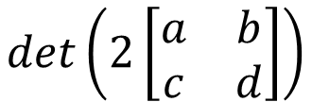
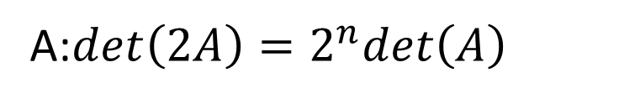
Three Basic Properties
Basic Property 3:
Determinant is “linear” for each row
3-a
$$det\left(\left[\begin{matrix}ta & tb \\ c & d\end{matrix}\right]\right)=tdet\left(\left[\begin{matrix}a & b \\ c & d\end{matrix}\right]\right)$$
$$det\left(2\left[\begin{matrix}a & b \\ c & d\end{matrix}\right]\right)$$
$$=det\left(\left[\begin{matrix}2a & 2b \\ 2c & 2d\end{matrix}\right]\right)$$
Q: find $det\left(2A\right)$
If A is n x n ……
$$=2det\left(\left[\begin{matrix}a & b \\ 2c & 2d\end{matrix}\right]\right)$$
$$=4det\left(\left[\begin{matrix}a & b \\ c & d\end{matrix}\right]\right)$$
A:$det\left(2A\right)=2^{n}det\left(A\right)$

Slide 9
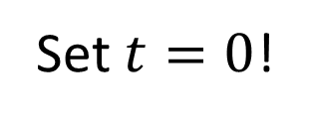

Three Basic Properties
Basic Property 3:
Determinant is “linear” for each row
3-a
$$det\left(\left[\begin{matrix}ta & tb \\ c & d\end{matrix}\right]\right)=tdet\left(\left[\begin{matrix}a & b \\ c & d\end{matrix}\right]\right)$$
A row of zeros
$$det\left(A\right)=0$$
Set $t=0$!
A row of zeros
“volume” is zero

Slide 10
Three Basic Properties
Basic Property 3:
Determinant is “linear” for each row
3-b
$$det\left(\left[\begin{matrix}a+a′ & b+b′ \\ c & d\end{matrix}\right]\right)=det\left(\left[\begin{matrix}a & b \\ c & d\end{matrix}\right]\right)+det\left(\left[\begin{matrix}a′ & b′ \\ c & d\end{matrix}\right]\right)$$
(c,d)
(c,d)
(a+a’,b+b’)
(a+a’,b+b’)
(a,b)
(a,b)

Slide 11
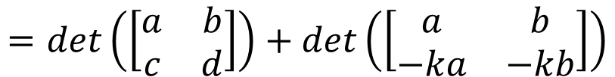
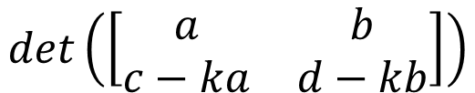
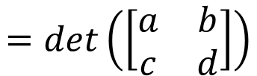
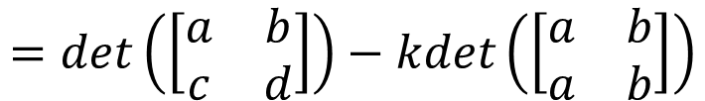
Three Basic Properties
Basic Property 3:
Determinant is “linear” for each row
Subtract k x row i from row j (elementary row operation)
Determinant doesn’t change
$$det\left(\left[\begin{matrix}a & b \\ c−ka & d−kb\end{matrix}\right]\right)$$
3-b
$$=det\left(\left[\begin{matrix}a & b \\ c & d\end{matrix}\right]\right)+det\left(\left[\begin{matrix}a & b \\ −ka & −kb\end{matrix}\right]\right)$$
3-a
$$=det\left(\left[\begin{matrix}a & b \\ c & d\end{matrix}\right]\right)−kdet\left(\left[\begin{matrix}a & b \\ a & b\end{matrix}\right]\right)$$
$$=det\left(\left[\begin{matrix}a & b \\ c & d\end{matrix}\right]\right)$$

Slide 12
Formulas Again
Notes:
Ref:
http://www.askamathematician.com/2013/05/q-why-are-determinants-defined-the-weird-way-they-are/

Slide 13
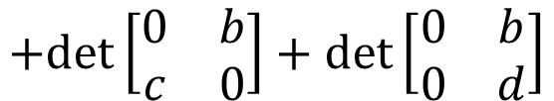

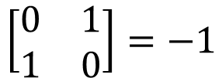
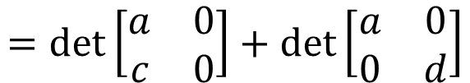

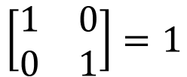
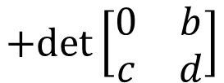

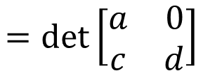

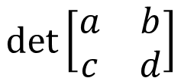

Formula from Three Properties
1
2
$$\left[\begin{matrix}1 & 0 \\ 0 & 1\end{matrix}\right]=1$$
$$\left[\begin{matrix}0 & 1 \\ 1 & 0\end{matrix}\right]=−1$$
$$det\left[\begin{matrix}a & b \\ c & d\end{matrix}\right]$$
$$=det\left[\begin{matrix}a & 0 \\ c & d\end{matrix}\right]$$
$$+det\left[\begin{matrix}0 & b \\ c & d\end{matrix}\right]$$
3-b
$$=det\left[\begin{matrix}a & 0 \\ c & 0\end{matrix}\right]+det\left[\begin{matrix}a & 0 \\ 0 & d\end{matrix}\right]$$
$$+det\left[\begin{matrix}0 & b \\ c & 0\end{matrix}\right]+det\left[\begin{matrix}0 & b \\ 0 & d\end{matrix}\right]$$
3-b
3-a
3-a
3-a
3-a
$$=0$$
$$=ad$$
$$=−bc$$
$$=0$$
$$=ad−bc$$

Slide 14
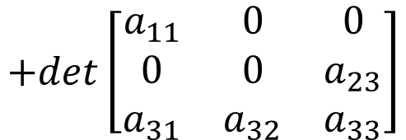
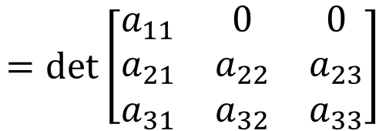
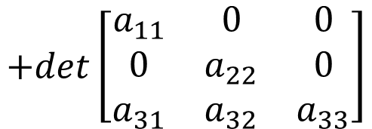
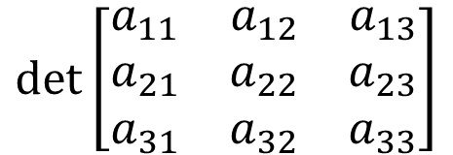
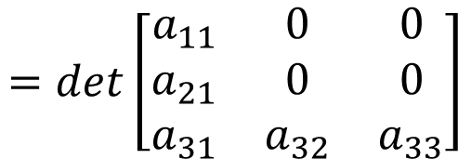
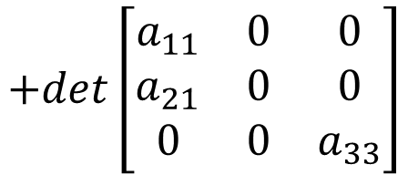
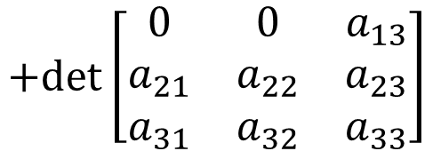
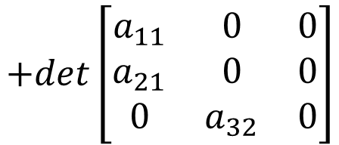
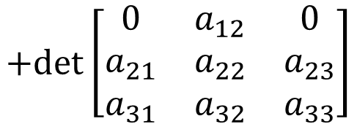
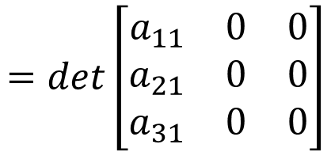
Finally, we get 3 x 3 x 3 matrices
$$det\left[\begin{matrix}a_{11} & a_{12} & a_{13} \\ a_{21} & a_{22} & a_{23} \\ a_{31} & a_{32} & a_{33}\end{matrix}\right]$$
Most of them have zero determinants
$$=det\left[\begin{matrix}a_{11} & 0 & 0 \\ a_{21} & a_{22} & a_{23} \\ a_{31} & a_{32} & a_{33}\end{matrix}\right]$$
$$+det\left[\begin{matrix}0 & a_{12} & 0 \\ a_{21} & a_{22} & a_{23} \\ a_{31} & a_{32} & a_{33}\end{matrix}\right]$$
$$+det\left[\begin{matrix}0 & 0 & a_{13} \\ a_{21} & a_{22} & a_{23} \\ a_{31} & a_{32} & a_{33}\end{matrix}\right]$$
$$=det\left[\begin{matrix}a_{11} & 0 & 0 \\ a_{21} & 0 & 0 \\ a_{31} & a_{32} & a_{33}\end{matrix}\right]$$
$$+det\left[\begin{matrix}a_{11} & 0 & 0 \\ 0 & a_{22} & 0 \\ a_{31} & a_{32} & a_{33}\end{matrix}\right]$$
$$+det\left[\begin{matrix}a_{11} & 0 & 0 \\ 0 & 0 & a_{23} \\ a_{31} & a_{32} & a_{33}\end{matrix}\right]$$
$$=det\left[\begin{matrix}a_{11} & 0 & 0 \\ a_{21} & 0 & 0 \\ a_{31} & 0 & 0\end{matrix}\right]$$
$$+det\left[\begin{matrix}a_{11} & 0 & 0 \\ a_{21} & 0 & 0 \\ 0 & a_{32} & 0\end{matrix}\right]$$
$$+det\left[\begin{matrix}a_{11} & 0 & 0 \\ a_{21} & 0 & 0 \\ 0 & 0 & a_{33}\end{matrix}\right]$$

Slide 15


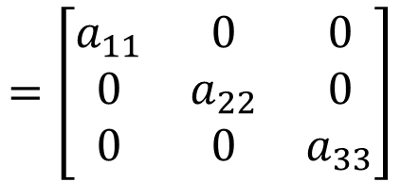
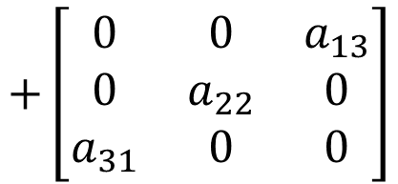

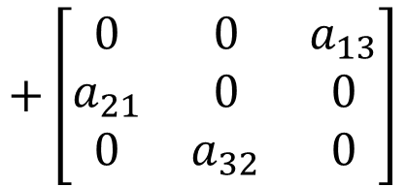

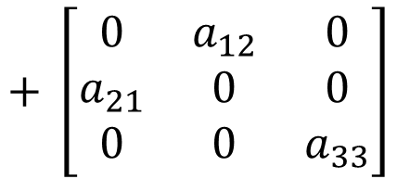

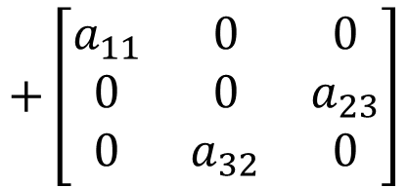

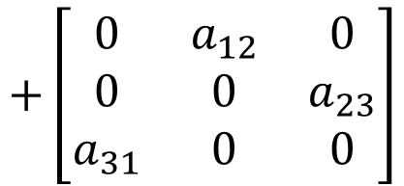
$$det\left[\begin{matrix}a_{11} & a_{12} & a_{13} \\ a_{21} & a_{22} & a_{23} \\ a_{31} & a_{32} & a_{33}\end{matrix}\right]$$
3! matrices have non-zero rows
$$=\left[\begin{matrix}a_{11} & 0 & 0 \\ 0 & a_{22} & 0 \\ 0 & 0 & a_{33}\end{matrix}\right]$$
$$+\left[\begin{matrix}a_{11} & 0 & 0 \\ 0 & 0 & a_{23} \\ 0 & a_{32} & 0\end{matrix}\right]$$
$$+ \left[\begin{matrix}0 & a_{12} & 0 \\ a_{21} & 0 & 0 \\ 0 & 0 & a_{33}\end{matrix}\right]$$
$$a_{11}a_{22}a_{33}$$
$$−a_{11}a_{23}a_{32}$$
$$−a_{12}a_{21}a_{33}$$
$$+\left[\begin{matrix}0 & a_{12} & 0 \\ 0 & 0 & a_{23} \\ a_{31} & 0 & 0\end{matrix}\right]$$
$$+\left[\begin{matrix}0 & 0 & a_{13} \\ a_{21} & 0 & 0 \\ 0 & a_{32} & 0\end{matrix}\right]$$
$$+\left[\begin{matrix}0 & 0 & a_{13} \\ 0 & a_{22} & 0 \\ a_{31} & 0 & 0\end{matrix}\right]$$
$$a_{12}a_{23}a_{31}$$
$$a_{13}a_{21}a_{32}$$
$$−a_{13}a_{22}a_{31}$$
Pick an element at each row,
but they can not be in the same column.

Slide 16

Formula from Three Properties
Given an n x n matrix A
$$det\left(A\right)=sum of n! terms$$
Format of each term:
$$a_{1α}a_{2β}a_{3γ}⋯a_{nω}$$
Find an element in each row
permutation of 1,2, …, n
Notes:
$$±$$

Slide 17



Example
$$det\left(\left[\begin{matrix}\begin{matrix}0 & 0 \\ 0 & 1\end{matrix} & \begin{matrix}1 & 1 \\ 1 & 0\end{matrix} \\ \begin{matrix}1 & 1 \\ 1 & 0\end{matrix} & \begin{matrix}0 & 0 \\ 0 & 1\end{matrix}\end{matrix}\right]\right)$$
$$=det\left(\left[\begin{matrix}\begin{matrix}0 & 0 \\ 0 & 1\end{matrix} & \begin{matrix}1 & 0 \\ 0 & 0\end{matrix} \\ \begin{matrix}1 & 0 \\ 0 & 0\end{matrix} & \begin{matrix}0 & 0 \\ 0 & 1\end{matrix}\end{matrix}\right]\right)$$
$$+det\left(\left[\begin{matrix}\begin{matrix}0 & 0 \\ 0 & 0\end{matrix} & \begin{matrix}0 & 1 \\ 1 & 0\end{matrix} \\ \begin{matrix}0 & 1 \\ 1 & 0\end{matrix} & \begin{matrix}0 & 0 \\ 0 & 0\end{matrix}\end{matrix}\right]\right)$$
-1
+1

